Slide 1

CS5304 – JAVA PROGRAMMING PBL
Project Review
AN INTERACTIVE JAVA TECHNICAL REVIEW SIMULATOR
Presentation by
RITHIKA S (2104251040779)
SHWETHAA JV (2104251050318)
Dept. of Computer Science & Engg.
Mentor
Dr. R. Kavitha, M.E., Ph.D.
Associate Professor
Dept. of Computer Science & Engg.

Slide 2
Problem & Objectives
Problem Statement
Campus placement drives include a core-Java technical round: OOP, Collections, Strings, Exceptions, JVM, Threads.
Engineering students preparing for placements are affected; most practise only with static notes or quizzes.
Without realistic practice and instant feedback, students cannot find their weak topics before the interview.
Existing options: no interactive mock interview, no per-answer scoring, no topic-wise diagnosis, often paid/online.
Our core-Java console simulator runs mock interviews, scores answers offline and reports placement readiness.
Objective
Build a JSON question bank for 6 Java topics.
Model the system with OOP classes & interfaces.
Offline keyword scoring + optional AI evaluator.
Report topic-wise placement readiness.
Verify the core logic with JUnit 5 tests.
Expected Outcome
An offline-capable Java console application that conducts a 5-question core-Java mock interview, scores every answer instantly with feedback and the model answer, and produces a topic-wise placement-readiness report (Ready / Almost There / Needs Preparation).
Verified by 34/34 passing JUnit 5 tests.

Slide 3
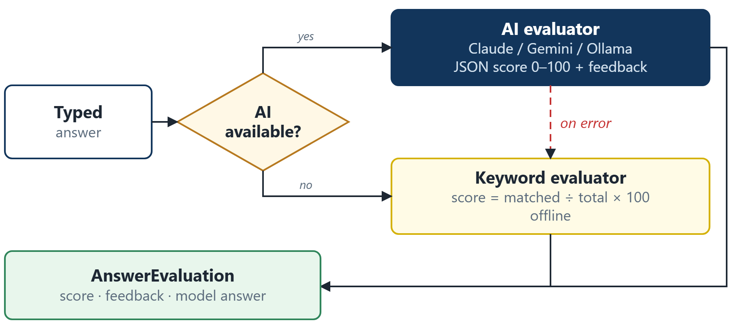
Input, Processing & Functional Analysis
Input/ Data Sources
Candidate profile: name, university, roll no.
Menu option and question-setting strategy
Typed answer for each interview question
questions.json: 23 questions with keywords
Optional: AI API key or local Ollama model
Processing / Functional Analysis
Validation: invalid menu input is re-prompted
Selection: Random / Balanced / Topic strategy
Scoring: AI evaluator or offline keyword match
Fallback: any AI failure → keyword evaluator
Output: topic-wise %, verdict and best score
Answer evaluation flow:
Key Functionalities
Candidate registration & profile statistics
Mock interview with 3 question strategies
Instant score, feedback & model answer
AI evaluation with automatic offline fallback
Readiness report & AI question generation

Slide 4
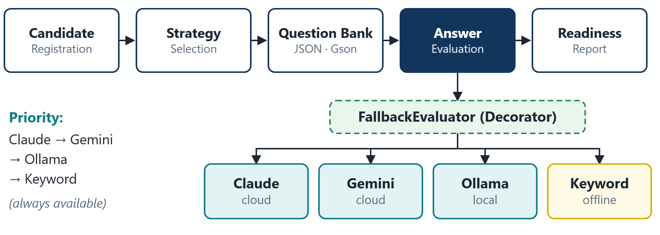
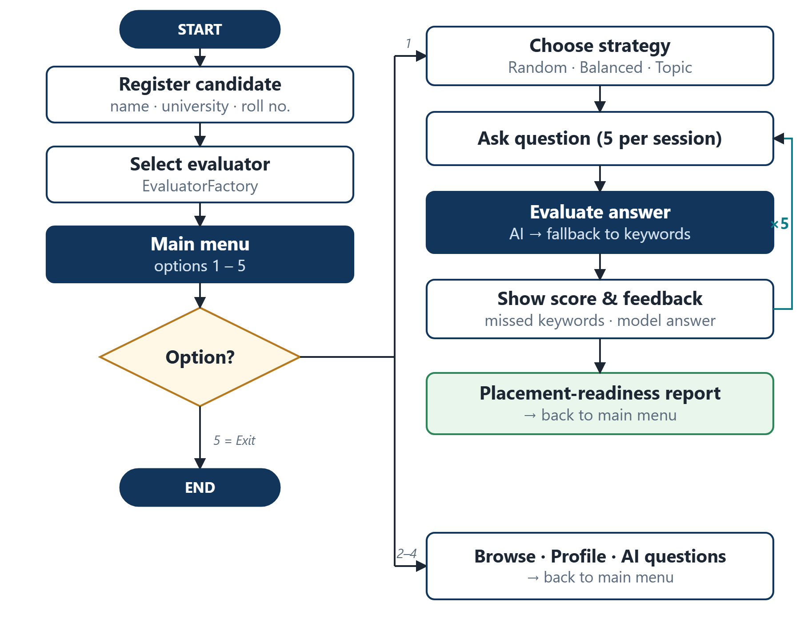
Technical Approach
System Architecture
Java Concepts and Implementation
OOP · Interfaces · Strategy, Factory & Decorator patterns · Collections · Exception handling · Gson · HttpClient · JUnit 5
Technology Stack
Programming Language: Java 17 (LTS)
IDE: VS Code / IntelliJ IDEA
Database: None (in-memory, questions.json)
Frameworks / Libraries: Gson 2.11.0, JUnit 5.10.2
APIs: Claude, Gemini, Ollama (optional)
Tools: Apache Maven 3.9.6, Git

Slide 5
Feasibility, Risk and Challenges
Feasibility
Technical Feasibility: Built entirely in core Java 17 with Gson and Maven; runs on any machine with a Java 17 runtime.
Operational Feasibility: Simple menu-driven console that works fully offline; AI evaluation is optional.
Economic Feasibility: Free, open-source tools; no database, server or paid service is required.
Schedule Feasibility: Two-member team over a 12-week PBL cycle; every milestone produced a runnable increment.
Scalability: Interfaces let new topics, question strategies, AI providers or a GUI/web front-end be added without changing the engine.
Risk and Challenges
Major challenges faced and how we handled them:
Invalid user input: caught and re-prompted
AI / network failures: FallbackEvaluator switches to keyword scoring
Unreliable AI replies: JSON extracted, score range-checked
Missing questions.json: loader warns and returns an empty list
Keyword scoring misses correctly paraphrased answers
Testing random selection: seeded Random in JUnit tests
Module integration: shared interfaces agreed first

Slide 6
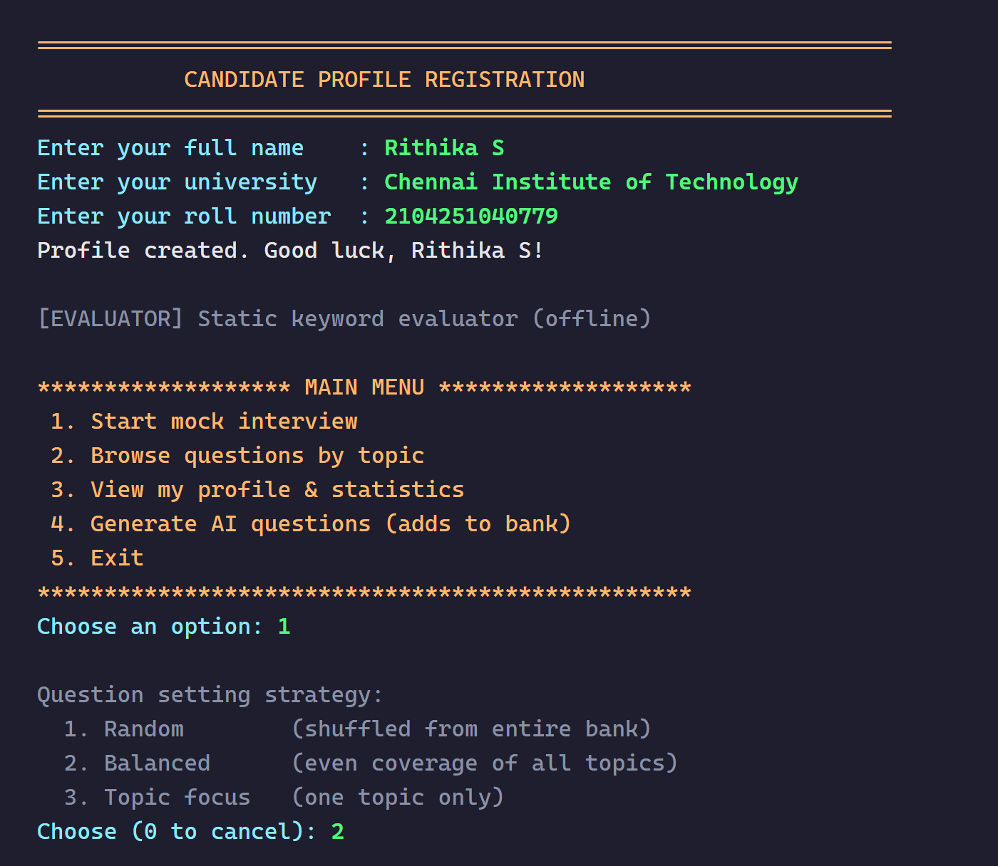
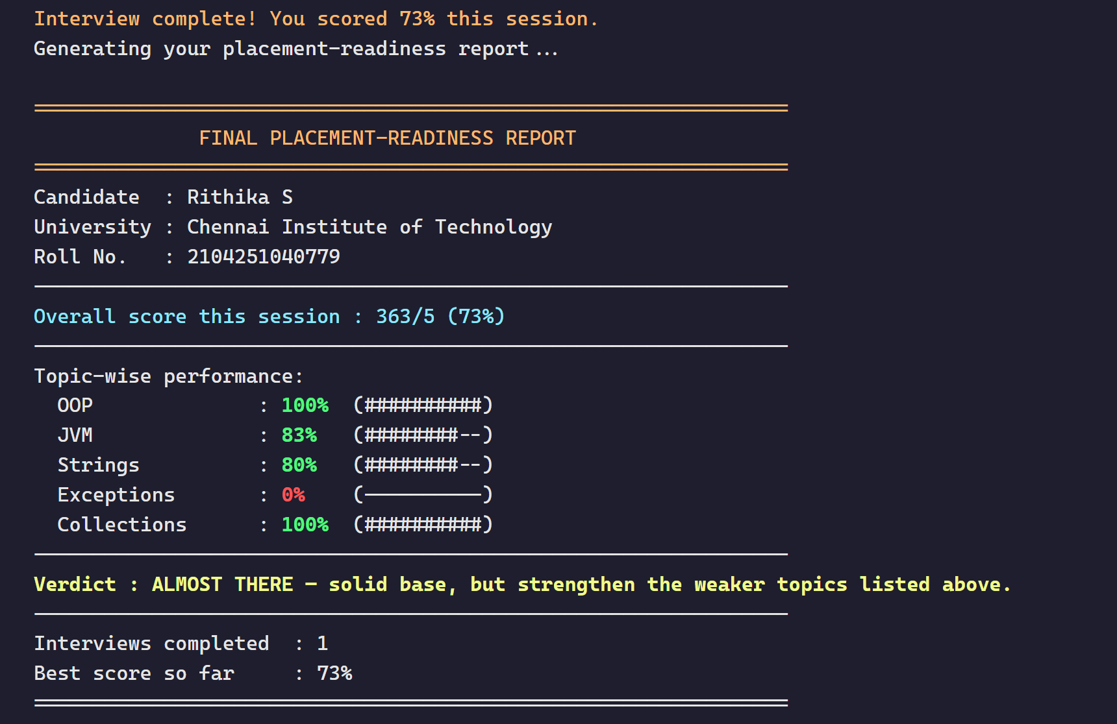
Result
Project Output
Sample run of the working application (Balanced strategy, offline keyword evaluator):
34/34 JUnit 5 tests passed · Sample session score 73% → Verdict: ALMOST THERE

Slide 7
Conclusion, Limitations & Future Scope
Conclusion
We developed An Interactive Java Technical Review Simulator using Java Programming to address the lack of an interactive, low-cost tool for core-Java interview practice. The developed application successfully implements the required functionalities and provides an efficient solution for engineering students preparing for campus placements.
It loads a 23-question bank from JSON, offers three question strategies, scores answers through an AI evaluator chain with offline fallback and produces a topic-wise readiness report; all 34 JUnit 5 tests pass.
Limitation
Keyword scoring misses correctly paraphrased answers.
No persistent storage; history resets on restart.
Small question bank: 23 questions, 6 topics.
Console-only, single-user application.
AI evaluators not yet tested end-to-end.
Future Scope
Semantic / embedding-based answer scoring.
Persistent storage for candidate history.
Larger, validated question bank.
GUI or web front-end on the same service layer.
JaCoCo coverage and end-to-end AI tests.

Slide 8

RITHIKA S, SHWETHAA JV
Dept. of Computer Science & Engg.
GitHub Repository

